Slide 1
Machine Learning
First Meet – Introduction [ADF19]
Agung Toto Wibowo
agungtoto@telkomuniversity.ac.id
WA: 081322513875
IG: atwbox
Fb : Agung Toto
http://agungtoto.web.id

Slide 2

Today’s Agenda
Introduction
Brief history of Machine Learning
Machine Learning

Slide 3
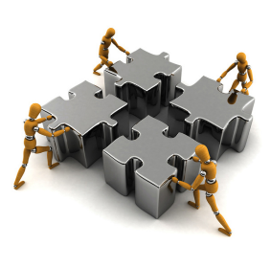
Course Introduction
Course Name: Machine Learning
Supervised,
Unsupervised,
Ensembles
Course Code: CII3C3
Credits : 3
14 weeks of each:
3 x 50’ class
3 x 50’ structured tasks
3 x 50’ self study
Machine Learning

Slide 4

Pre-requisite
Proficiency in Algorithm and Programming
Basic Algorithm and Programming
Algorithm Analysis and Design
Calculus
Linear Algebra
Probabilistic and Statistics
Artificial Intelligence
Machine Learning

Slide 5
Course Objectives
Students are able to explain the concept of each machine learning method.
Students are able to identify, model, analyze and solve problems using machine learning methods.
Students are able to implement machine learning methods using programming languages to solve problems.
Machine Learning

Slide 6
Syllabus & CLO
Lets Open the RPS
Machine Learning

Slide 7

Scoring
Komponen Penilaian: a. 60% Tugas Besar, b. 10% Kuis/Tugas Dosen (4x)
Tugas Besar
hanya ada 1 tugas mencakup Unsupervised, Supervised, dan Ensemble dengan 1 kasus (dataset)
Unsupervised: Melakukan clustering dg k-means (program dibangun dari awal)
Supervised: Melakukan regresi atau klasifikasi, metode bebas, boleh library
Tugas diberikan saat/setelah masa UTSs
Penilaian oleh dosen pada 2 pertemuan presentasi
NO MID/FINAL EXAM
Machine Learning

Slide 8
Final Points
A | 80 … 100.0
AB | 75 … 79.99
B | 70 … 74.99
BC | 60 … 69.99
C | 50 … 59.99
D | 40 … 49.99
E | 0 ... 39.99
Machine Learning

Slide 9
Academic Honesty and Collaboration policy
Convolutional Neural Network

Slide 10

Rule 1
Don’t look at solutions or code that are not your own
Everything you submit should be your own work
Convolutional Neural Network

Slide 11
Rule 2
Don’t share your solution code with others
However discussing ideas or general strategies is fine and encouraged
Convolutional Neural Network

Slide 12

Rule 3
Be responsible with your attendance
Any kind of Cheating and Plagiarism is not acceptable and will not be forgiven
Maintain the appropriate condition in the class
Mind your manners and attitudes
You may bring snacks and drinks but please no noisy or strong-smelling ones
Drowsy? Just sleep quietly
Language?
Machine Learning

Slide 13
Turning in something late/incomplete is better than violating the honor code
Convolutional Neural Network

Slide 14
Link
anditya.staff.telkomuniversity.ac.id/academic/mcl
Machine Learning

Slide 15
References
[1] Suyanto, "Machine Learning: Tingkat Dasar dan Lanjut", Penerbit Informatika, Bandung, 2018
[2] Miroslav Kubat, "An Introduction to Machine Learninge" Second Edition, Springer, 2017.
[3] Suyanto, "Data Mining untuk Klasifikasi dan Klasterisasi Data", Penerbit Informatika, Bandung, 2017.
[4] Suyanto, "Deep Learning: Modernisasi Machine Learning untuk Big Data", Penerbit Informatika, Bandung, 2019.
[5] Max Bramer, "Principles of Data Mining" Third Edition, Springer, 2017.
[6] Richard S. Sutton and Andrew G. Barto, "Reinforcement Learning - An Introduction" Second Edition, The MIT Press, Cambridge, Massachusetts, London, England, 2020
Machine Learning

Slide 16
Introduction to Machine Learning
Machine Learning

Slide 17

What is Machine Learning?
Machine
computer, computer program (in this course)
Learning
improving performance on a given task, based on experience / examples
Machine Learning
concerned with computer programs that automatically improve their performance through experience
Machine Learning

Slide 18
What is Machine Learning?
Very hard to write programs that solve problems
Example: Recognizing three-dimensional object
Don’t know how it’s done in our brain ➔ don’t know what to write
Even if we had a good idea about how to do it, program might be horrendously complicated
Machine Learning

Slide 19
What is Machine Learning?
Instead of the programmer writing explicit rules for how to solve a given problem,
We collect lots of examples that specify the correct output for a given input
The programmer instructs the computer how to learn from examples
Machine Learning

Slide 20
What is Machine Learning?
The program produced may look very different from a typical hand-written program
In many cases the computer program can even become better at the task than the programmer is!
Massive amount of computation are now cheaper than paying someone to write a task-specific program
Machine Learning

Slide 21
Learn from Data
One definition of machine learning: A computer program improves its performance on a given task with experience (i.e. examples, data).
Thus we need to separate:
Task: What is the problem that the program is solving?
Performance measure: How is the performance of the program (when solving the given task) evaluated?
Experience: What is the data (examples) that the program is using to improve its performance?
Machine Learning

Slide 22
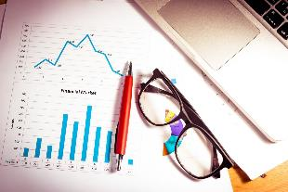
Availability of data
These days it is very easy to
collect data (sensors are cheap, much information digital)
store data (hard drives are big and cheap)
transmit data (essentially free on the internet).
But how to benefit from it?
Analysis is becoming key!
Machine Learning

Slide 23
Related Scientific Disciplines
Machine Learning

Slide 24
Related Scientific Disciplines
Artificial Intelligence (AI)
Machine learning can be seen as 'one approach' towards implementing 'intelligent' machines (or at least machines that behave in a seemingly intelligent way).
Artificial neural networks, computational neuroscience
Inspired by and trying to mimic the function of biological brains, in order to make computers that learn from experience.
Modern machine learning really grew out of the neural networks boom in the 1980's and early 1990's.
Machine Learning

Slide 25
Related Scientific Disciplines
Pattern recognition
Recognizing objects and identifying people in controlled or uncontrolled settings, from images, audio, etc. Such tasks typically require machine learning techniques.
Statistics
Traditionally: focus on testing hypotheses based on theory
Has contributed a lot to data mining and machine learning, and has also evolved by incorporating ideas derived from these fields
Machine Learning

Slide 26
Related Scientific Disciplines
Data mining
Trying to identify interesting and useful associations and patterns in huge datasets
Focus on scalable algorithms
Example: On the order of 3 million people grocery shopping twice a week in just two main chains in Finland ) each chain would collect hundreds of thousands of transaction receipts per day!
Machine Learning

Slide 27
Machine Learning Taxonomy
Machine Learning

Slide 28
Deep Learning
Example: Shallow
autoencoders
Example: MLPs
Example: Logistic
regression
Example: Knowledge
bases
Representation Learning
Machine Learning
AI
Machine Learning
Notes:
From Deep Learning Book by Ian Goodfellow, Yoshua Bengio, Aaron Courville

Slide 29
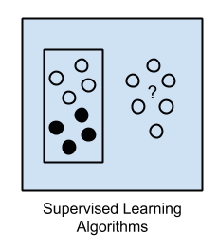
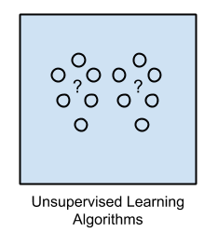
Machine Learning Taxonomy
Supervised Learning
Unsupervised Learning
Reinforcement Learning
Machine Learning

Slide 30
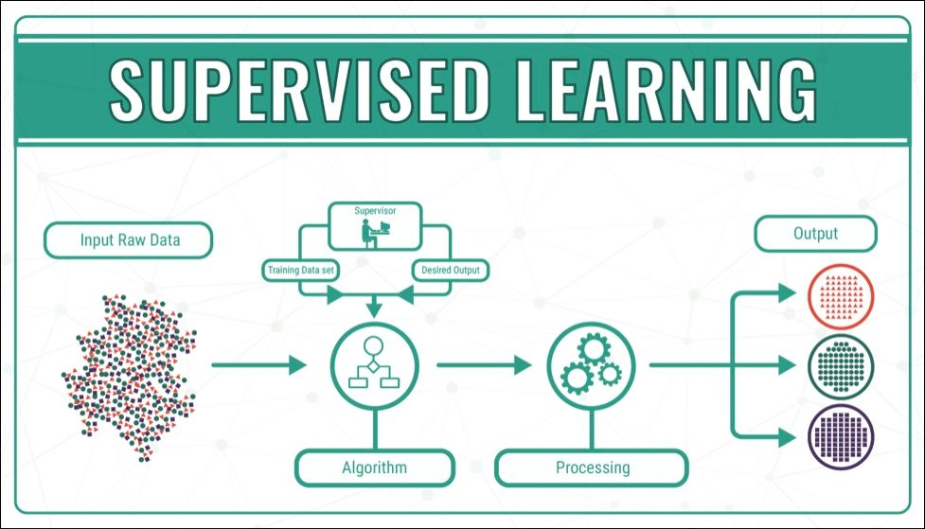
Machine Learning

Slide 31
Supervised Learning
we have a data set that includes the target values (the values we wish to predict).
try to learn a function that correctly maps the target values from the other features, which can then be used to make predictions about other examples.
Two flavors:
Classification: output is label
Regression: output is value
Machine Learning

Slide 32
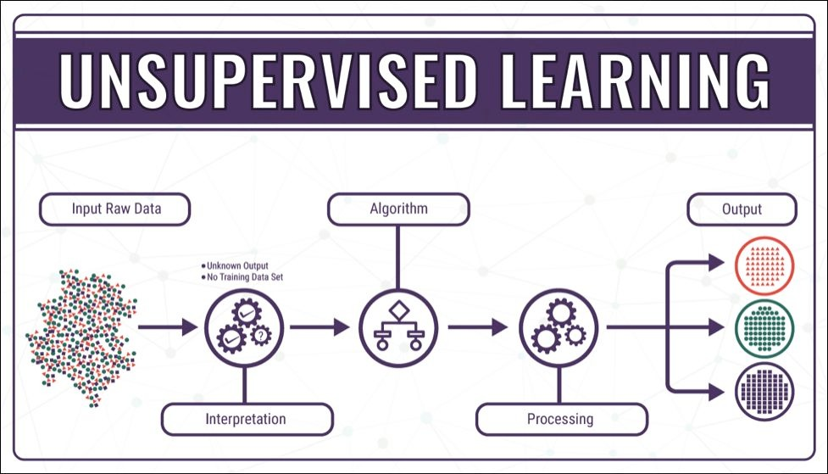
Machine Learning

Slide 33
Unsupervised Learning
We have a dataset but there is no target to be predicted.
Discover a good internal representation of the input
Example: clustering, density estimation, noise reduction.
Semi-Supervised
Machine Learning

Slide 34
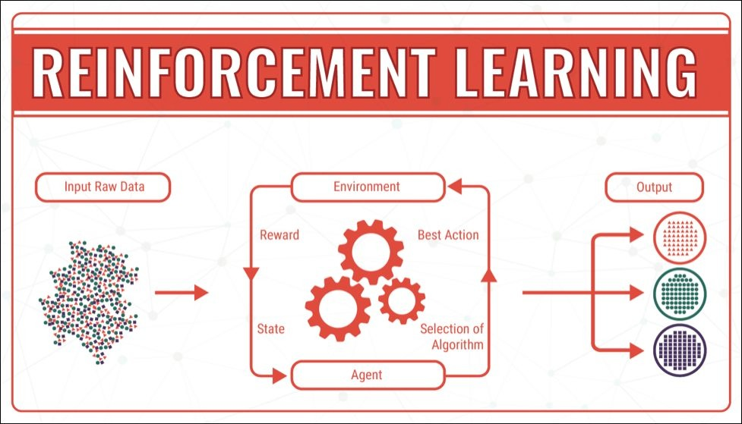
Machine Learning

Slide 35
Reinforcement Learning
Learn to select an action to maximize payoff (future rewards)
A reward and punishment function is provided that tells us how “good” certain states/actions are.
Making a decision now influences what decisions we can make in the future.
Machine Learning

Slide 36
Ensembles Method
use multiple learning algorithms to obtain better predictive performance than could be obtained from any of the constituent learning algorithms alone
Machine Learning

Slide 37

Machine Learning

Slide 38
Examples
Machine Learning

Slide 39
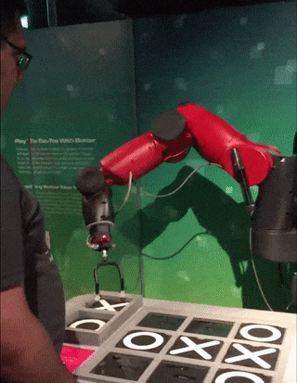
Tic-Tac-Toe
How to program the computer to play tic-tac-toe?
Machine Learning

Slide 40
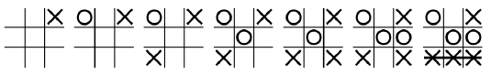
Tic-Tac-Toe
How to program the computer to play tic-tac-toe?
Option A: The programmer writes explicit rules, e.g. 'if the opponent has two in a row, and the third is free, stop it by placing your mark there', etc. (lots of work, difficult, not at all scalable!)
Option B: Go through the game tree, choose optimally (for non-trivial games, must be combined with some heuristics to restrict tree size)
Machine Learning

Slide 41
Tic-Tac-Toe
How to program the computer to play tic-tac-toe?
Option C: Let the computer try out various strategies by playing against itself and others, and noting which strategies lead to winning and which to losing (='machine learning')
Machine Learning

Slide 42
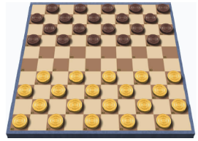
Checker Game
Arthur Samuel (50's and 60's):
Computer program that learns to play checkers
Program plays against itself thousands of times, learns which positions are good and which are bad (i.e. which lead to winning and which to losing)
The computer program eventually becomes much better than the programmer.
Machine Learning

Slide 43

Spam Filtering
Traditional: Programmer writes rules:
ex: If it contains 'viagra' then it is spam.
(difficult, not user-adaptive)
Machine Learning:
The user marks which mails are spam, which are legit, and the computer learns itself what words are predictive
Machine Learning

Slide 44
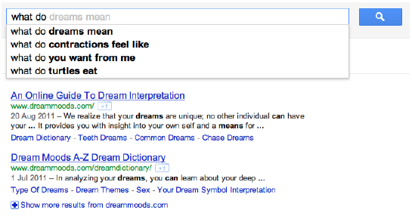
Prediction of search queries
Traditional:
The programmer provides a standard dictionary
(words and expressions change!)
Machine Learning:
Previous search queries are used as examples!
Machine Learning

Slide 45
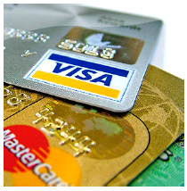
Detecting credit card fraud
Credit card companies typically end up paying for fraud (stolen cards, stolen card numbers)
Useful to try to detect fraud, for instance large transactions
Important to be adaptive to the behaviors of customers, i.e. learn from existing data how users normally behave, and try to detect 'unusual' transactions
Machine Learning

Slide 46

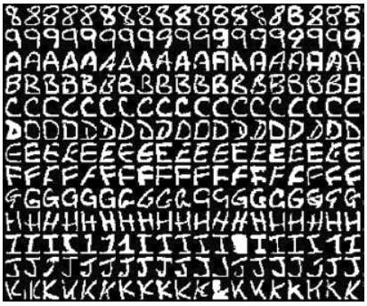
Character recognition
Automatically sorting mail (handwritten characters)
Digitizing old books and newspapers into easily searchable format (printed characters)
Machine Learning

Slide 47
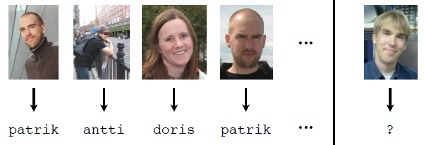
Face Recognition
Traditional: Programmer writes rules:
ex: If short dark hair, big nose, then it is Alex
(impossible! how do we judge the size of the nose?!)
Machine Learning:
The computer is shown many (image, name) example pairs, and the computer learns which features of the images are predictive (difficult, but not impossible)
Machine Learning

Slide 48
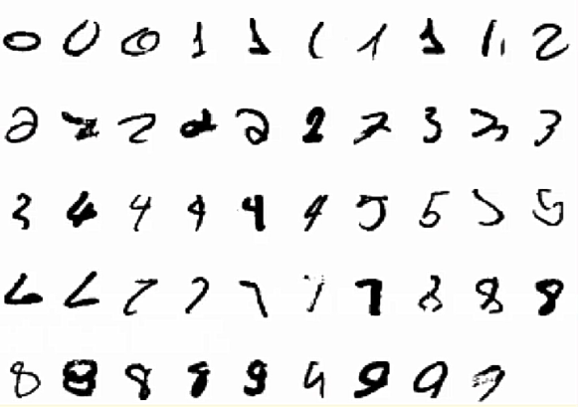
Character recognition
Machine Learning

Slide 49
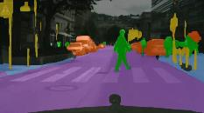
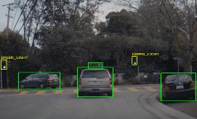
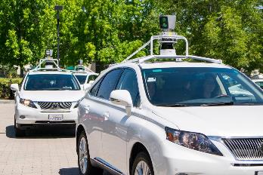
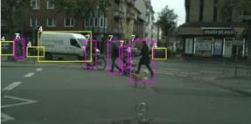
Self-driving cars
Sensors (radars, cameras) superior to humans
How to make the computer react appropriately to the sensor data?
Machine Learning

Slide 50

Social Media Analysis
Mining chat and discussion forums
Breaking news
Detecting outbreaks of infectious disease
Tracking consumer sentiment about companies / products
Prediction of friends in Facebook, or prediction of who you’d like to follow on Twitter.

Slide 51
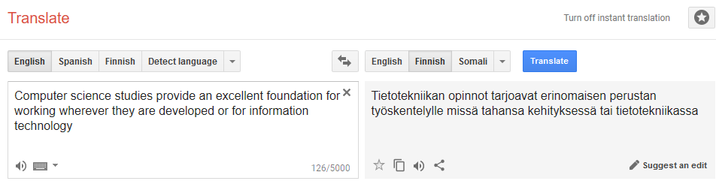
Machine Translation
Traditional:
Dictionary and explicit grammar
Machine Learning:
statistical machine translation based on example data is increasingly being used
Machine Learning

Slide 52

Automatic Speech Recognition
recognize human speech, so that the computer can listen, write, understand, even answer the user's speech
Text-to-Speech
Google Duplex
Machine Learning

Slide 53
Todays AI
Artificial Intelligence

Slide 54
Todays AI
[2011] IBM’s Watson won a game of Jeopardy against the top two all-time champions
[2015-2018] Neural Net beat human accuracy in 1000-class Visual Recognition in IMAGENET

Slide 55
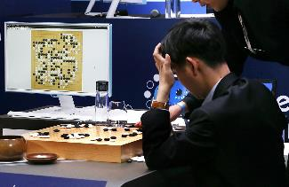
Deep Mind’s AlphaGo
the first computer program to defeat a professional human Go player
1st version: used a dataset of more than 100,000 Go games as a starting point for its own knowledge
Win 4-1 vs Lee Sedol in 2016
one of the strongest players in the history of Go
Awarded an "honorary 9 dan"
Machine Learning

Slide 56
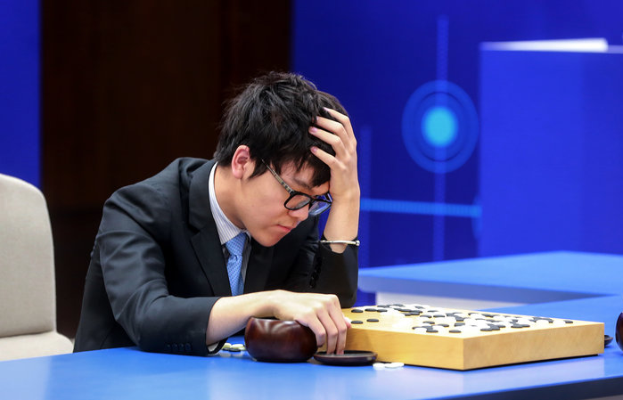
Deep Mind’s AlphaGo Zero
2nd version of AlphaGo: Learning from scratch
Reinforcement Learning
a version without human data and stronger than any previous human-champion-defeating version only by playing games against itself
Faster training to reach the same level
Win 2-1 vs Ke Jie in 2017
current world No. 1 ranking player
Machine Learning

Slide 57
Todays AI
[2017] DeepBlue beat poker pro players
[2017] Elon Musk’s OpenAI Dota2 bot beat pro player
[2018] A portrait created by AI just sold for $432,000.
[2018] Video to Video Synthesis

Slide 58

Question?
Machine Learning

